Slide 1





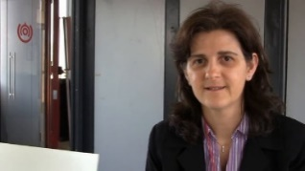
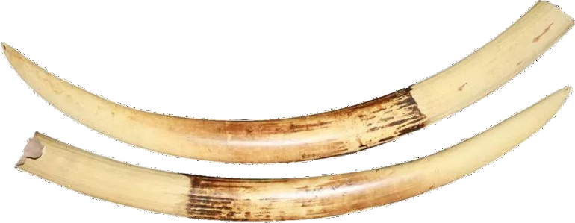
Compositional Simulation of
Abstract State Machines for Safety Critical Systems
Silvia Bonfanti
University of Bergamo
(Italy)
Angelo Gargantini
University of Bergamo
(Italy)
Elvinia Riccobene
University of Milan
(Italy)
Patrizia Scandurra
University of Bergamo
(Italy)
From FACS 2022
IVOIRE 2023
Bonfanti, S., Gargantini, A., Riccobene, E., Scandurra, P. (2022). Compositional Simulation of Abstract State Machines for Safety Critical Systems. In: Tapia Tarifa, S.L., Proença, J. (eds) Formal Aspects of Component Software. FACS 2022. Lecture Notes in Computer Science, vol 13712. Springer, Cham. https://doi.org/10.1007/978-3-031-20872-0_1
Notes:
Good morning. It’s a pleasure to start the first session of the conference.
Today I’m going to present a joint work with…

Slide 2
Outline
Introduction
  On the need of compositional (V&V) analysis techniques for software-intensive systems
Compositional simulation of Abstract State Machines (ASMs)
  Background concepts about ASMs
  Compositional simulation of I/O ASMs
    technique overview through an illustrative example
Validation on the MVM (Mechanical Ventilator Milano) developed during Covid19
  brief overview and results
Conclusion and future works
Notes:
Let me start with a brief outline of my presentation.
First, I will drive your attention on the need of formal methods at runtime for checking the requirements compliance for software-intensive systems, and
on the necessity of composable formal models and analysis for such systems.
Then I will present a compositional simulation technique for the formal method Abstract State Machines (ASMs), that is a state-based formalism for modelling discrete systems.
Then I will sum up the results and lesson learned in applying the proposed technique for prototyping the behaviour of the MVM (Mechanical Ventilator Milano) developed during Covid19.
Finally, I will conclude my presentation with some future lines of research.

Slide 3

On the need of composing models and analysis
Some V&V techniques:
  verification techniques: quantitative verification, verification (monitoring), statistical model checking, etc.
  validation techniques: model simulation (interactive, random, by scenarios, etc.), (online) model-based testing, etc.
With the growing size and complexity of systems, composable models and analysis are also needed to
  keep requirements and models under control and
  explore and combine multi-paradigm modeling techniques
Need of a compositional simulation technique for ASMs to orchestrate the execution of ASM models of independent and interacting subsystems of a discrete-event system
Notes:
Luckly runtime v&v techniques already exist. Some runtime verification approaches employing model checking of (temporal logics) properties of interest already exist and used over time. These include… …[leggere elenco] Runtime validation techniques include …[leggere elenco] Validation techniques are less time and resource consuming compared to verification approaches, but they do not provide exhaustive analysis results. However, since systems are rapidly growing in complexity and scale, runtime validation techniques may appear sometimes the only viable solution. For example, simulation-based testing is becoming a popular approach for testing autonomous driving systems (ADS), by considering different types of scenario under different driving conditions.
However, since systems are rapidly growing in complexity and scale, also system models are growing in complexity and scale!
So it is becoming important to efficiently and effectively manage a system model as a composition of different sub-models to analyze separately and then integrate both at design time and at run-time. This is important not only to keep the requirements and models under control with a modular approach but also to explore and combine multi-paradigm formalisms to model different aspects of software-intensive systems. Think for example to the multifaceted nature of CPSs.
Towards this direction, here we present a compositional model-based simulation technique to co-simulate ASMs representing independent
and interacting subsystems of a discrete-event system under prototyping.
----------------------
Runtime verification methods take advantage of the fact that variables that are free at design time are bound at runtime; so, instead of verifying the complete state space, as in classical model checking at design time, runtime verification techniques may concentrate on checking the current state of a system.
However, even if the state space of a system under specification is smaller than in model checking at design time, formal verification is usually costly at runtime.

Slide 4

The ASMETA (ASMmETAmodeling) toolset
Academic project, started around 2015
A set of modeling and analysis tools for ASMs based on MDE principles
Stepwise model-based development
  via V&V and C++ code generation
Safety assurance through formal analysis @design-time and @run-time
https://asmeta.github.io/
Notes:
ASMETA is a set of modeling and analysis tools for ASMs.
The project is an academic initiative started 15 years old as a joint collaboration between the Universities of Milan and Bergamo.
The toolset follows the Model-driven Engineering principles. So the starting point was the definition of the abstract syntax (in terms of an ecore metamodel) of a modeling language for ASMs, and then we developed new analysis tools around it.
ASMETA is based on the Eclipse Modeling Framework [and released under the Eclipse Public License (EPL).]
ASMETA allows stepwise model-based development through several V&V techniques and C++ code generation. ASMETA adopts different modeling notations: we have a user-facing textual notation for defining ASM models, and other notations used by the supported V&V techniques and their related tools.
ASMETA supports formal analysis techniques that work both at design-time and at run- time.
Model refinement and transformations ensure that the initial and resulting models/code are consistent with each other.
For more technical details on the tool set, please visit the our github repository.
---------------------------------------
At each refinement level, already at the level of the ground model, different V&V activities can be carried out (like interactive simulation, scenario-based simulation, model animation, property verification by model checking, etc.). Model to code transformation is supported for C++ code.
Two runtime analysis techniques are also supported for the conformance checking, i.e. to check if the implementation, if externally provided, conforms to its model. The tool ATGT can be used to automatically generate tests from ASM models and, therefore, to check the conformance offline; CoMA, instead, can be used to perform runtime verification, i.e., to check the conformance online, i.e. @runtime.

Slide 5
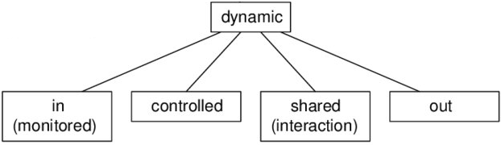
ASMs background concepts
ASMs are state-based transition systems:
  states: domains of abstract elements with functions defined on them
    loc = (f,(v₁,…,v_{n})) is a location (the ASM memory unit!)
      at each state, each location has a value (loc, value)
  transitions: named rules describe how locations change from one state to the next
    Location update loc : = v is the basic unit of state change (update rule)
    rule constructors: guarded update (if-then, switch-case), simultaneous parallel updates (par, forall), sequential updates (seq), non-deterministic updates (choose)
(location functions)
ASM function classification:
(output of the machine)
(only of the machine)
(input of the machine)
(read and written by the machine and its environment)
Notes:
Let me give you some preliminary concepts about ASMs.
Essentially, an ASM is a state-based transition system:
The states are domains of objects with functions f of a certain arity defined on them. [Thus the states of ASMs are algebraic structures, also called simply algebras, as introduced in standard logic or universal algebra textbooks.]
The interpretation of such functions can change from one state to the next.
The pair of a function f and its arguments v1,..,vn are called locations and are the memory units of an ASM. At each state, each location has a value.
State transitions are performed by firing named transition rules, which change functions interpretation from one state to the next one and, therefore, they change location values.
Locations are updated through assignments rule of the form loc := v, where loc is a location and v its new value. They are the basic units of rules construction.
By a limited number but powerful set of rule constructors, location updates can be combined to express other forms of machine actions as: guarded actions (if-then, switch-case), simultaneous parallel actions (par and forall), sequential actions (seq), non-deterministic actions (choose).
Locations’ functions can be distinguished in monitored or in functions (read by the machine and modified by the environment), out (written by the machine and read by the environment), controlled (read and written only by the machine), shared (read and written by the machine and its environment).
An I/O ASM is therefore an ASM with in and out functions, which are to be intended as its I/O interface.

Slide 6
ASM execution (or run)
  A run of an ASM M:
    a finite or infinite sequence S₀, S₁, …, S_{n}, …, of states of M
    S₀ is an initial state
    each S_{n+1} is obtained from S_{n} by firing the unique main rule that is the starting point of the machine execution and in turn fires other transitions rules
S₀
S₁
S₂
…..
State: instantaneous conﬁguration of the system and its environment
State transition: application of the main rule to the previous state (update)
Notes:
An ASM computation (or run) is defined as a finite or infinite sequence S0, S1,. . . , Sn, . . . of states of the machine, where S0 is an initial state and each Sn+1
is obtained from Sn by firing the set of all transition rules invoked by a unique main rule, which is the starting point of the computation.

Slide 7
I/O ASM
An I/O ASM is
  an ASM model 𝑚 with a set 𝐼𝑚 of input (or monitored) functions and a set 𝑂𝑚 of out functions in its signature,
    where 𝐼𝑚 and 𝑂𝑚 cannot be both empty.
  We denote by (𝐼𝑚, 𝑚, 𝑂𝑚 ) an I/O ASM

Slide 8
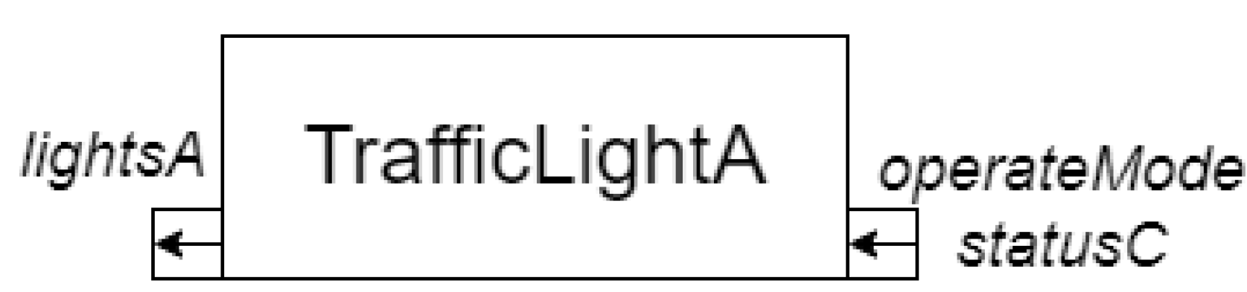
I/O ASM example: two-way traffic light system
Using the AsmetaL textual language: ASM model for traffic light A
Main rule
I/O functions
Named rule
Initial state
function update rule
Black-box view through a informal graphical notation:
Notes:
From a practitioner viewpoint, ASMs can be indented as a precise form of executable pseudo-code!
To illustrate concepts, we use here a well-known example in the literature, that is the two-way traffic light control system.
A controller manages two traffic lights A and B.
Here you only the ASM model of one traffic light machine, let’s say traffic light A. The controller and the traffic light B are two other ASMs non shown here. The section “signature” declares all the domains and functions of the model. The traffic lights can be off, red light on, green light on, yellow light on, or yellow blinking.
The controller operates in six modes: both traffic lights are red, one is red and the other is green, one is red and the other is yellow.
The output of the ASM is the light value of the traffic light A. The status and mode (statusC and operateMode) of the external controller are the input for the traffic light machine.
The section “definitions” contains the transition rule r_operateSubState and the main rule r_Main (the starting point of the computation). The initial state is defined in the section “default init”. Initially, the controller and the traffic lights are off. When the turn on command is received by the controller, the traffic lights are set to yellow blinking until the operate command is received. When the standby command is received
the traffic lights are set to yellow blinking and when the controller is turned off, the traffic lights are turned off as well.
ASM state invariants (not shown here) can be also specified to express, for example, safety assertions.
Below you see …

Slide 9
ASM binding and assembly
I/O ASM binding: Given two I/O ASMs, 𝑚𝑖 and 𝑚𝑗 , an I/O binding exists from 𝑚𝑖 to 𝑚𝑗 iff 𝑂𝑚𝑖 ∩𝐼𝑚𝑗 ≠ ∅.
We denote by 𝑚𝑖 ⇒ 𝐵𝑖,𝑗⇒ 𝑚𝑗 the I/O binding from 𝑚𝑖 to 𝑚𝑗 ,
  where 𝐵𝑖,𝑗 = 𝑂𝑚𝑖 ∩ 𝐼𝑚𝑗 is the set of binding functions.
I/O ASM assembly: An I/O ASM assembly is a set of I/O ASMs bound together by I/O ASM bindings.

Slide 10
I/O ASMs assembly
Several I/O ASMs can communicate over I/O bindings (read: connections via in/out ASM locations) and form an I/O ASM assembly
Example: I/O ASM assembly for the two-way traffic light system (graphical black-box view)
transitionC
operateMode
statusC
Controller
operateMode
statusC
lightsA
TrafficLightA
TrafficLightB
lightsB
Controller ={coperateMode, StatusC} => TrafficLightB
Notes:
More formal definitions are provided within the paper, but essentially the idea is that I/O ASMs can interact by binding their input and out functions with the same symbol name, same domain and codomain, and same interpretation.
So several I/O ASMs can execute and communicate over I/O bindings to form a whole ASM assembly.
As an example, here you can see the ASM assembly of the traffic light system.

Slide 11
Compositional simulation of I/O ASMs
An I/O ASM assembly can be executed according to a composition (or orchestration) formula defined recursively as:
  A I/O ASM composition formula c over an ASM assembly A is:
    a single I/O ASM m belonging to A, with input I_{m} , output O_{m} and locations values currState(m)
    or c1 op c2 where c1 and c2 are composition formulas and op is a (binary) composition operator from the set:
      | (simplex) pipe or sequence
      <|> half-duplex bidirectional pipe
      <> full-duplex bidirectional pipe
      || synchronous parallel split (or fork-join)
  Example: (m1 <|> (m2 || m3)) | m4
Notes:
Once defined an I/O ASM assembly, the overall execution of such an assembly can be done by orchestrating or coordinating the I/O ASMs involved.
The orchestration can be specified through a composition formula defined recursively as follows: …
Different types of composition operators are allowed. Their semantics is intuitive.
The composition formula c = (m1 <|> (m2 || m3)) | m4 denotes, for example, the execution schema of four ASM models, where the output of the bidirectional
pipe between m1 and the parallel of m2 and m3, is given as input to m4 connected through a pipe.
------------------
We denote by Curr_state(m) the set of locations values of m.

Slide 12
Compositional Simulation Tree of I/O ASMs
It is a special kind of binary tree with the following properties:
  Each leaf is an operand (an I/O ASM and its current state).
  Examples: m₁, m₂, m₃, and m₄
  The root and internal nodes are composition operators.
  Examples: |, <|>, ||
I
Intuitively, an execution step of an I/O ASM composition is a recursive traversal of its CST
to evaluate nodes according to their type.
<I>
m4
m1
II
7
1
m2
  Example: CST for (m1 <|> (m2 || m3)) | m4
4
m3
4
Notes:
A composition formula can be represented in memory by a compositional simulation tree.
It is a special kind of expression binary tree with the following properties:
Each leaf is an operand (namely an I/O ASM and its current state. Examples: m1, m2, m3, and m4
The root and internal nodes are composition operators. Examples: I, <|>, ||,
Subtrees are subexpressions with the root being an operator.
Intuitively, an execution step of an I/O ASM composition is a recursive pre-order traversal of the corresponding CST to visit nodes (from the root to leaves) and evaluate them according to their type.
As an example, the picture shows the visit of a Compositional Simulation Tree for this orange formula. Gray labels 1, 4, and 7 denote the steps of the models to update their location values, while black labels 2, 3, 5, 6, and 8 denote copying and pasting of the binding function values according to the semantics of the composition operators.
In case an I/O ASM model fails, the composition expression fails and the faulty ASM model and all models already executed in the composition are rolled-back.

Slide 13
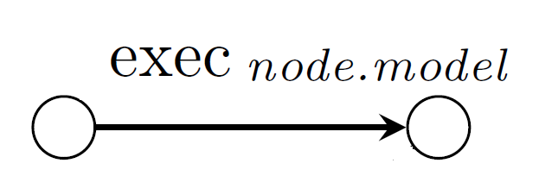
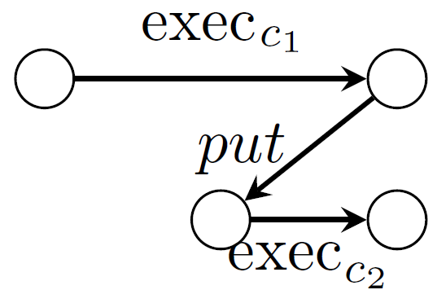
Runstep of an I/O ASM composition
Node | Execution: inputs → outputs
Leaf: | run a step of node.model on input I return node.model.getOutLocations();
(Siplex) Pipe: C1 | C2 | // execute C1 on the inputs I O_1 = exec(C1,I) // copy the ouputs to the inputs of C2 put(C1, C2,B_1,2) // execute C2 O_2 = exec(C2,I) // return all the outputs return O_1 U O_2
Given a CST T_{c} for a composition c, the output of the algorithm is the set O_{c} of ASM out functions values in the (final) current state of the I/O ASMs at the leaf nodes
Intuitive graphical execution semantics of the composition operators
Notes:
More formally, the execCST in Algorithm 1 is the pseudocode of a simplified version of a CST traversal without considering the roll-back of models in case a failure occurs during model execution.
So a runstep of a composition c of I/O ASMs is the depth (pre-order) traversal as given by Algorithm 1: execCST.
The recursive traversal exec is the Algorithm 2 exec, that is invoked intitially by Algorithm 1 on the root node.
Nodes are visited depending on their type. An intuitive graphical representation of the execution steps of the various composition operators is depicted on the left side of Algorithm 2.
In case of a leaf node, the I/O ASM model at the leaf node is executed.
In case of an internal node, the composition operator at the node is executed according to its execution semantics.
The algorithm uses the subroutine put(c1,c2,B_1,2) to copy/transfer the values of the I/O binding functions from a composition subformula to another. It’s like a copy and paste action.

Slide 14
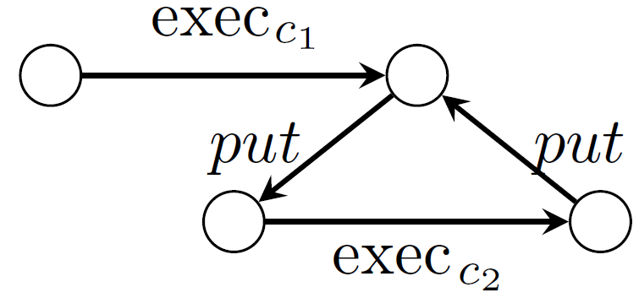
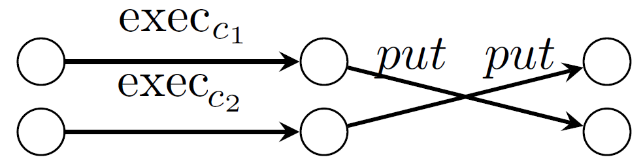
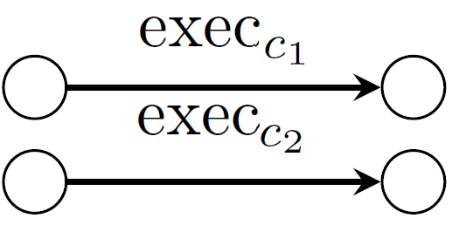
Runstep of an I/O ASM composition
Node |  | Execution: inputs → outputs
<|>half-duplex bidirectional pipe C1 <|> C2 |  | // execute C1 on the inputs I and report the outputs to C2 O_1 = exec(C1,I) put(C1, C2,B_1,2) // execute C2 and report back the outputs to C1 O_2 = exec(C2,I) put(C1, C2,B_2,1) return O_1 U O_2
<||> full-duplex bidirectional pipe C1 <||> C2 |  | // execute C1 and C2 on the inputs I O_1 = exec(C1,I) O_2 = exec(C2,I) // copy the ouputs to the inputs of C2 put(C1, C2,B_1,2) put(C1, C2,B_2,1) return O_1 U O_2
|| synchronous parallel split (or fork-join) C1 || C2 |  | // execute C1 and C2 in parallel on the inputs I O_1 = exec(C1,I) O_2 = exec(C2,I) // return all the outputs return O_1 U O_2
Notes:
More formally, the execCST in Algorithm 1 is the pseudocode of a simplified version of a CST traversal without considering the roll-back of models in case a failure occurs during model execution.
So a runstep of a composition c of I/O ASMs is the depth (pre-order) traversal as given by Algorithm 1: execCST.
The recursive traversal exec is the Algorithm 2 exec, that is invoked intitially by Algorithm 1 on the root node.
Nodes are visited depending on their type. An intuitive graphical representation of the execution steps of the various composition operators is depicted on the left side of Algorithm 2.
In case of a leaf node, the I/O ASM model at the leaf node is executed.
In case of an internal node, the composition operator at the node is executed according to its execution semantics.
The algorithm uses the subroutine put(c1,c2,B_1,2) to copy/transfer the values of the I/O binding functions from a composition subformula to another. It’s like a copy and paste action.

Slide 15
Composing the execution steps
I
8
exec((m1 <|> (m2 || m3)) | m4)
…
(1) exec(m1)
(2) put( m1, m2 || m3, ...)
...
(4) exec(m2)
....
<I>
6
m4
m1
6
II
7
2
1
5
m2
3
4
m3
4

Slide 16
ASMETAComp GUI
Compositional simulation of the two way-traffic light system
Composition formula: controller.asm | (trafficlightA.asm || trafficlightB.asm)
Notes:
To implement the compositional simulation of I/O ASMs in practice, we developed the tool ASMETAComp as part of the ASMETA toolset and it is based on the ASM simulator @runtime.
ASMETAComp can be used through a basic graphical user interface or a command line or shell. Using the AsmetaComp shell the user can set and run a composition of models interactively or via a script of commands.
Here you see some screenshots of the GUI. Using the GUI, as shown in the Fig. (a), the user can open from the local file system the models involved in the assembly and specify the composition formula through a input dialog window.
The models are loaded and shown in a separate windows. The compositional execution can then be executed step by step according to the execution semantics of the formula.
For our running example, we simulate a simple pipe from the controller to the parallel of two traffic lights (TrafficLightA and TrafficLightB).
At each step (the user sets the value of monitored functions and) the controller is executed (see Fig. 2b). Depending on the output produced by the controller, the
traffic lights (see Fig. 2c and Fig. 2d) set their light value accordingly. For example, after step1 of the controller, status is standby and therefore this fires in parallell step 1 of trafficlightA and trafficlightB and the lights are blink yellow. Similarly, after step 2 of the controller, both the traffic lights are turned red.

Slide 17
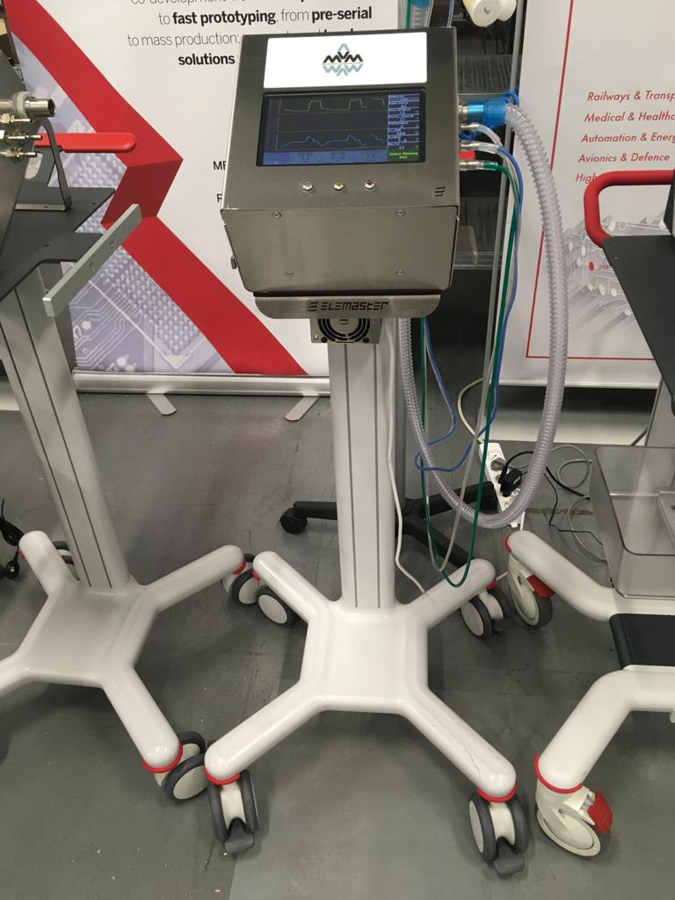
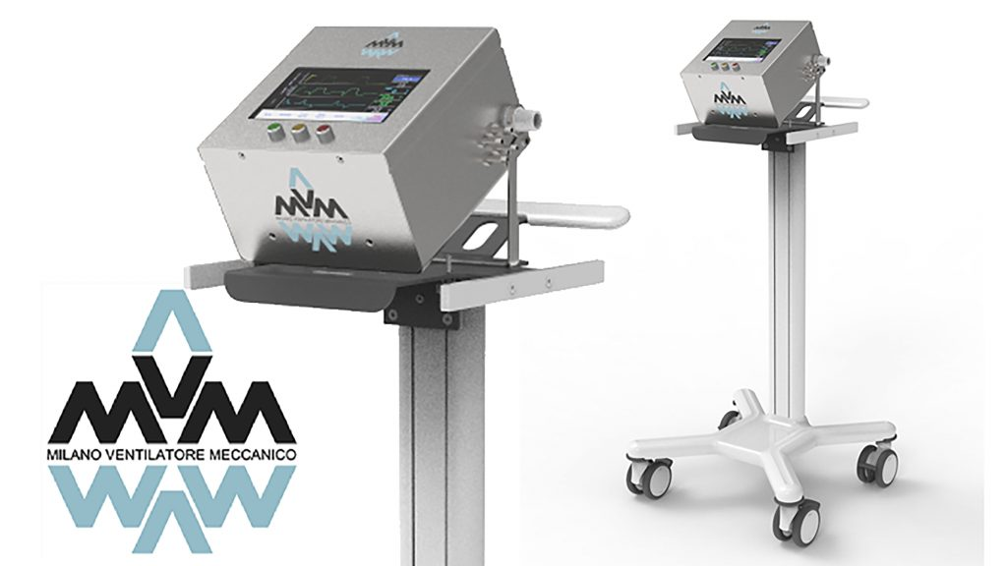
Application to MVM
Notes:
MVM it's an Electromechanical ventilator developed using off the shelf components and it was developed to support patients in ICU's using the ventilation modes based on pressure.
The project is born under the leadership of Cristiano Galbiati professor at university of Princeton GSSI in Italy, and dozens of physics of the dark side project, including Nobel prize Art McDonald, contributed to MVM development. Once the first prototype was available, computer scientists were involved in the project to finalize the code and produce the required certification for documentation.

Slide 18
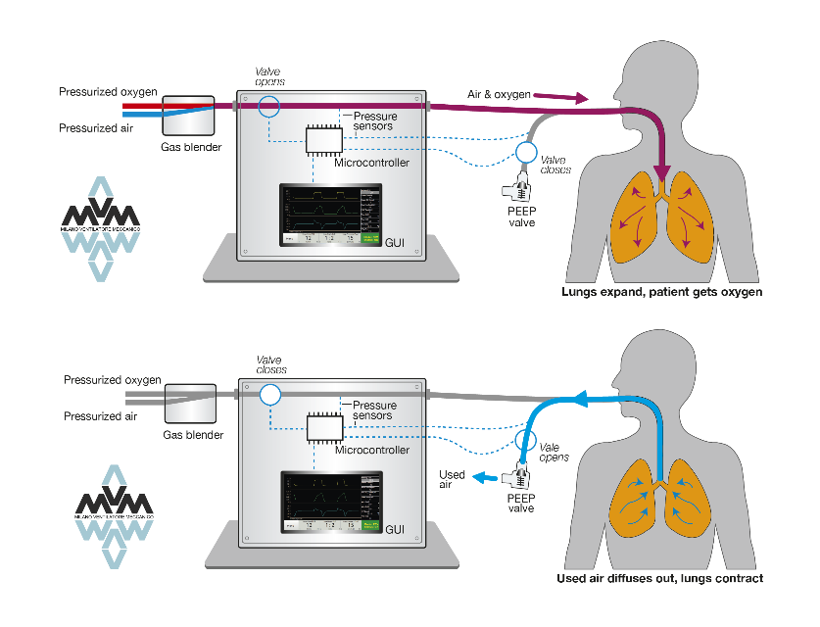
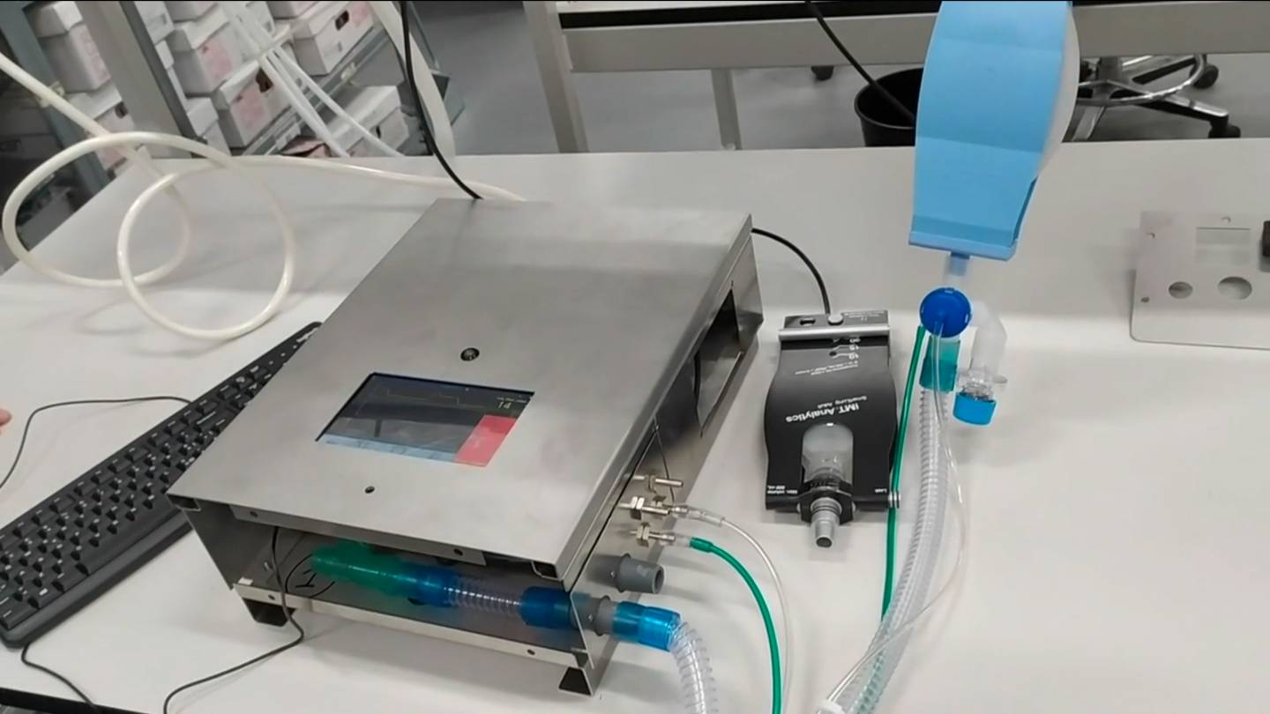
Mechanical Ventilator Milano
Electro-mechanical ventilator
Support for patients that are in intensive therapy: pressure controlled
Requires a source of compressed oxygen and medical air
Developed Under the leadership of Cristiano Galbiati
  Professor at Princeton and GSSI Italy
  Dozens of physicists – darkside project
  Including Nobel prize Art McDonald
Simple design
  Using off the shelf components (like an Arduino-like microcontroller)
A first prototype was ready by the middle of April 2020
Notes:
Cristian author

Slide 19



One «small» problem: the software!!!
The quality of the software must be assessed
  SQA: software quality assessment
  IEC 62304 Medical device software – Software life cycle processes
Involvement of computer scientists

Slide 20



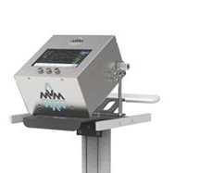


MVM Timeline
02/2021
7300 ventilators delivered to Canadian Government
19/03/2020
Project starts
01/05/2020
US FDA Emergency Use Authorization
30/09/2020
Health Canada Interim Order approval
21/02/2020
First patient in Italy
30/07/2020
Health Canada submission
09/3/2020
Lockdown in Italy and collapse of the ICUs
04/2021
MVM obtains CE mark
19/04/2020
First series production units in Italy
30/11/2020
Canadian Standards Association (CSA) certification
Notes:
The goal of the MVM project was to develop during COVID a ventilator to support patients in ICU. The peculiarity of this project is that it has been developed in few months. At the end of February 2020, the first patient has been diagnose, the 9/03/2020 the Italy was in lockdown and the ICUs were collapsed due to lack of ventilators. The 19th of March the project started and the first series of MVM was already available by 19 of April. the first of may MVM obtained the emergency use of authorization by FDA to use the ventilator during the emergency in case no already certified ventilators were available. then decertification process by the Health Canada started at the end of July and at the end of November the ventilator obtained Health Canada approval. Then in April 2021 and MVM obtained also the CE mark.

Slide 21
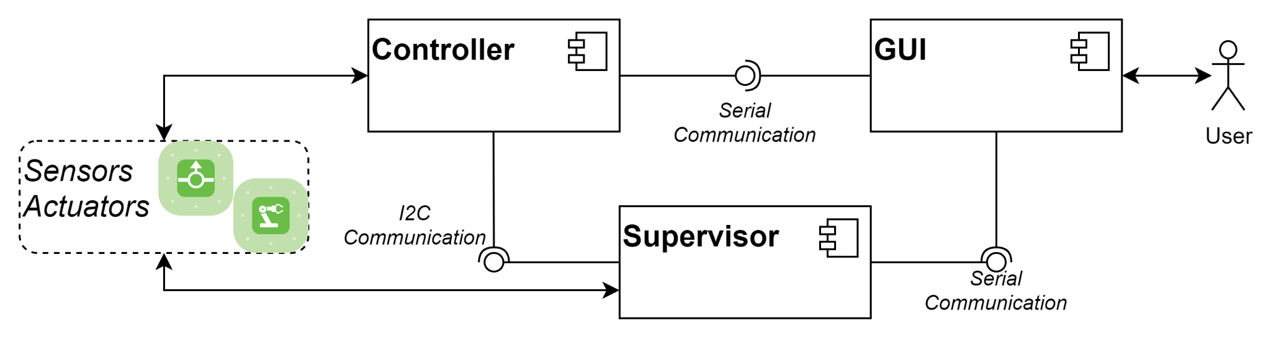
MVM Software components
Notes:
The MVM software is composed by three components, the GUI that allow users to interact with a ventilator, the supervisor who supervises the operation of the entire system and the controller that is responsible to manage valves status that allow patients to perform inspiration and expiration. The controller has been implemented using Yakindu statechart tool that given the state machine of the system, is able to automatically generate code.

Slide 22
Application to MVM
Hardware.asm <|> (Controller.asm <|> Supervisor.asm)
Model of medium-size
n. lines: about 600,
n. functions: 39 (controller) 55 (supervisor)
n. rules: 28 (controller), 29 (supervisor)
Notes:
We applied this simulation technique to a real system, namely Mechanical Ventilator Milano (MVM) for securing patients on mechanical ventilation in case of apnea lag and lung stress. The ventilator was developed during COVID-19 pandemic by an international, interdisciplinary team. It is inexpensive and simple to manufacture, and has received authorization from U.S. and Canadian agencies.
This ventilator is a cyber-physical system that has software and appropriate hardware to control the pumping of air into the lungs of patients unable to ventilate.
The MVM is made of different interacting hardware/software subsystems with human-in-the-loop. These subsystems have been developed by different
Interdisciplinary teams. Modeling the entire system in one single ASM model would be impractical and produce a complex big model difficult to manage, analyze and share with all groups.
Our compositional modeling process started from a formal specification of the MVM subsystems as separate ASM models, which were then validated and verified independently.
The compositional simulation technique was then used to compose by orchestration the subsystems models according to established I/O signals and ASM assembly of the MVM components. Therefore, we validated by scenario-based simulation the composed model of the MVM system by checking if it behaves in accordance with the expected outcomes from the
requirements. The results of such modeling and validation approach helped us to clarify and improve the MVM component interfaces and the communication protocol, while taming the system model complexity.
—--------------------------
NO
The action of the ventilator is a function of the signals received from sensors attached to the patient and to the valves of the fluid-dynamic system, and to a series of physical parameters such as the lung capacity of an average human and the resistance to the insufflation of air into the lungs.
We advocate the use of:
Discrete Event Formalisms to model the evolution of the state of the ventilator-patient system that depends on the occurrence of events. Examples are Mealy/Moore/State machines, Petri Net, and their stochastic and hybrid extensions.
We then conducted an evaluation about soundness and computation overhead of the proposed enforcement software.
We observed a high overhead, mostly do to the he execution time of the ASM model. Indeed, the ASM@run.time Simulator
is based on the design-time simulator AsmetaS, which is a simulator of formal models, developed in Java for model validation purposes and not for obtaining fast performance. To overcome such limitation we should consider in the future the availability of an optimized version of the simulator that exploits specific optimizations and customized properties at the level of the Java virtual machine.

Slide 23
Validation and lesson learned
Soundness: the compositional simulation by scenarios conformed to the intended orchestrated behavior of the overall compound system
Usability: ASMETAComp is based on the design-time simulator AsmetaS, not optimized for fast co-execution at runtime with highly reactive systems
-> to re-think
Notes:
We applied this simulation technique to a real system, namely Mechanical Ventilator Milano (MVM) for securing patients on mechanical ventilation in case of apnea lag and lung stress. The ventilator was developed during COVID-19 pandemic by an international, interdisciplinary team. It is inexpensive and simple to manufacture, and has received authorization from U.S. and Canadian agencies.
This ventilator is a cyber-physical system that has software and appropriate hardware to control the pumping of air into the lungs of patients unable to ventilate.
The MVM is made of different interacting hardware/software subsystems with human-in-the-loop. These subsystems have been developed by different
Interdisciplinary teams. Modeling the entire system in one single ASM model would be impractical and produce a complex big model difficult to manage, analyze and share with all groups.
Our compositional modeling process started from a formal specification of the MVM subsystems as separate ASM models, which were then validated and verified independently.
The compositional simulation technique was then used to compose by orchestration the subsystems models according to established I/O signals and ASM assembly of the MVM components. Therefore, we validated by scenario-based simulation the composed model of the MVM system by checking if it behaves in accordance with the expected outcomes from the
requirements. The results of such modeling and validation approach helped us to clarify and improve the MVM component interfaces and the communication protocol, while taming the system model complexity.
—--------------------------
NO
The action of the ventilator is a function of the signals received from sensors attached to the patient and to the valves of the fluid-dynamic system, and to a series of physical parameters such as the lung capacity of an average human and the resistance to the insufflation of air into the lungs.
We advocate the use of:
Discrete Event Formalisms to model the evolution of the state of the ventilator-patient system that depends on the occurrence of events. Examples are Mealy/Moore/State machines, Petri Net, and their stochastic and hybrid extensions.
We then conducted an evaluation about soundness and computation overhead of the proposed enforcement software.
We observed a high overhead, mostly do to the he execution time of the ASM model. Indeed, the ASM@run.time Simulator
is based on the design-time simulator AsmetaS, which is a simulator of formal models, developed in Java for model validation purposes and not for obtaining fast performance. To overcome such limitation we should consider in the future the availability of an optimized version of the simulator that exploits specific optimizations and customized properties at the level of the Java virtual machine.

Slide 24
Conclusion and future directions
We presented a formal approach to distributed discrete system modeling and prototyping based on the orchestrated simulation of separate I/O ASMs
Future works:
  Extend AsmetaComp to support simulation of I/O ASMs running on separate local or remote machines/computational nodes
  Support additional composition operators (conditional execution, alternate execution, non-deterministic choice, etc.) and other BPMN-like choreography constructs for decentralized co-simulation of ASMs
  Support the co-simulation of ASM models with other simulated/real software systems in accordance with standards for distributed co-simulation
Notes:
And now let me summing up our work.
Formal methods at runtime can contribute to high-quality software spanning the entire system’s life cycle, from requirements inception to and throughout operation.
Composition of system models and their analysis is a challenging but unavoidable issue for today’s complex systems.
In this paper, we have formulated a basic composition mechanism working for I/O ASMs.
We have also presented, through the MVM case study, the scope and practical use of this compositional simulation
technique as supported by the ASMETA tool AsmetaComp.
OPPURE: We presented a formal approach to distributed discrete system modeling and prototyping based on the compositional simulation of I/O ASMs
As future work, we want to:
extend the tool AsmetaComp to support simulation of I/O ASMs in a distributed setting, namely by allowing separate ASM
system models to co-execute possibly on separate local or remote processes/computers.
We also want to support additional composition operators (such as I/O wrapping, conditional execution, iterated execution, alternate execution, attempt choice, non-deterministic choice, etc.). We also would like to support choreography constructs for decentralized co-simulation of asynchronous ASMs as provided in the standard Business Process modeling Notation 2.0 (BPMN2) Choreography Diagram.
Moreover, we want to support the co-simulation of ASM models with other simulated or real subsystems in accordance with standards such as the IEEE 1516 High
Level Architecture (HLA) and the Functional Mockup Interface (FMI) for distributed co-simulation.

