Slide 1
Scenario-based validation in ASMETA concepts, uses, new ideas
Angelo Gargantini
​Department of Management, Information and Production Engineering
University of Bergamo
In collaboration with many
Paolo Arcaini, Andrea Bombarda, Silvia Bonfanti, Elvinia Riccobene, Patrizia Scandurra
IVOIRE 2022

Slide 2
Scenario-based validation
What it is
A philosophical view of scenarios
Details about the ASMETA approach (writing, executing, semantics …)
Uses and advantages
New ideas:
  Scenarios and animation/simulation
  Scenarios and refinement
  Scenarios and requirements traceability
  Automatic generation of scenarios
Generation of unit tests for code from scenarios

Slide 3
Motivations
Validation: investigating a model with respect to its user perceptions, in order to ensure that the it really satisfies the user needs
  detect faults as early as possible
  possible techniques: scenarios generation, development of prototypes, animation, simulation, and also testing
Scenario: description of a possible behavior of the system
  observable interactions between the system and its environment in specific situations

Slide 4
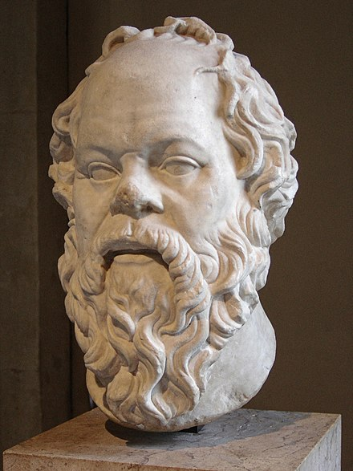
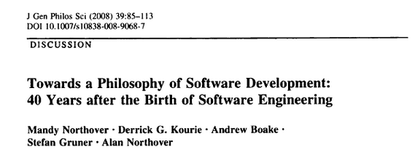
A philosophical view
MODEL
All men are mortal.
Model checking and similar techniques
VERIFICATION
Socrates is a man implies Socrates is mortal.
Scenario-based VALIDATION
Find Socrates, check he is a man, and he is dead
testing
“the susceptibility of a formal specification to scenario-based validation demonstrates its falsifiability, and thus the scientific nature of software development.”

Slide 5
Related works 1
From telecommunication systems
  Message Sequence Charts (MSCs) (graphical)
  Life Sequence Charts (LSCs)
    W. Damm and D. Harel. LCSs: Breathing life into message sequence charts: extends the MSCs by providing the "clear and usable syntax and a formal semantics" MSCs lack of.
UML Use cases
  black box view – graphical notation
Temporal Logical/ formal methods
    Albert II formal language and scenarios are represented by MSC
For ASM
  W. Grieskamp, N. Tillmann, and M. Veanes. Instrumenting scenarios in a model-driven development environment, 2004.
  Spec# specifications are instrumented to allow validation
    E.g. “to describe observations in scenarios, we extend Spec# by the so-called expect statement”

Slide 6
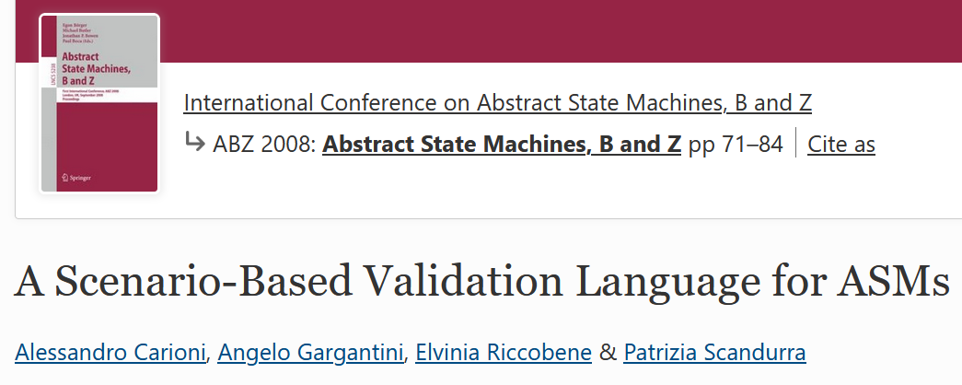
Our proposal in ASMETA – ABZ08

Slide 7

From UML Actor to ASM Actor
UML USE CASE:
actor interacts with the system.
One or more scenarios may be generated from each use case
BLACK BOX VIEW
SYSTEM
set
USE CASE 1
check
USE CASE n
user actor
ASM Actor
sets monitored and shared functions (environment)
checks out functions (machine reaction)

Slide 8
AValLa primitives
set | A command to set the location of a (monitored) function to a specific value: it simulates the environment
check | To inspect external values and (only for the observer ) to inspect internal values in the current state
Step | To signal that the environment has finished to update the monitored locations, hence the machine can perform a step
StepUntil | To signal that the machine can perform a step iteratively until a specified condition becomes true
Invariant | To state critical specification properties that should always hold for a scenario
Exec | To execute transition rule when required by the observer

Slide 9
Lift Example
Syntax defined used xtext
scenario lift2_s0
load ./lift2.asm
// init monitored functions
set hasToDeliverAt(lift1, 0) := false;
set existsCallFromTo(0, UP) := false;
set existsCallFromTo(0, DOWN) := false;
…
check floor(lift1) = 0;
check ctlState(lift1) = HALTING;
check dir(lift1) = UP;
step
check floor(lift1) = 0;
check ctlState(lift1) = HALTING;
check dir(lift1) = UP;
validate lift2.asm
Set the button at ground floor to off
Switch off all the buttons
Check that the lift is halted at ground floor, direction UP
Make a step
Check again

Slide 10
AValLa sematics
Semantics of a metamodel-based language L can be given by an ASM-based semantic framework
  some details in the paper
Intuition
  every program written in L becomes an ASM
  definition of a mapping M from the elements of L to elements of ASM
  M can be defined at the metamodel (abstract syntax) level
For AValLa
  Given a scenario, obtain an ASM (validating ASM)

Slide 11
In practice …
sc1.test
scenario sc1
load lift.asm
set …
lift_sc1.asm
asm lift_sc1
…
M
lift.asm
asm lift
…
VALIDATING ASM
ASM to be validated

Slide 12
M for AValLa elements
AValLa | AsmM
Set l:=v | UpdateRule l:=v
Check expr | ConditionalRule with guard expr and body allChecksOk := false
Invariant expr | Axiom expr
Exec | Rule
Step | MacroDeclaration r_step_i
StepUntil | Two macroDeclations r_step_i and r_step_i_until

Slide 13
Use of scenarios
Regression testing
  Scenario can be executed to check the modifications do not introduce unintended behaviors
    Scenario-driven development?
    What about refinement?
Coverage
  Scenario can give a measure of which rules are covered
    When stopping writing scenarios?
    Or better use mutation testing?
  Traceability (later)
    Link between scenarios and rules is useful trace requirements to scenarios

Slide 14



AsmetaValidator
PASS/FAIL
COVERAGE
scenario
AsmetaV
Semantic mapping
M
Asmeta
Simulator
AsmetaL spec
INSPECTION
WINDOW
validating AsmetaL

Slide 15


Lift scenarios
 |  | # Commands | Coverage
S0 | The lift is halted at ground floor, no request, it should stay | 18 | 6/8
S1 | External request at the same floor (ground) and direction, internal request for floor 2. The lift should reach floor 2 | 24 | 7/8
S2 | External request at floor 4, enters and ask for floor 2 | 22 | 8/8
s3 | All external (UP and DOWN) buttons have been pushed. The lift reaches the top floor and UP requests are canceled | 4 – 1 invariant | 8/8

Slide 16
New ideas

Slide 17
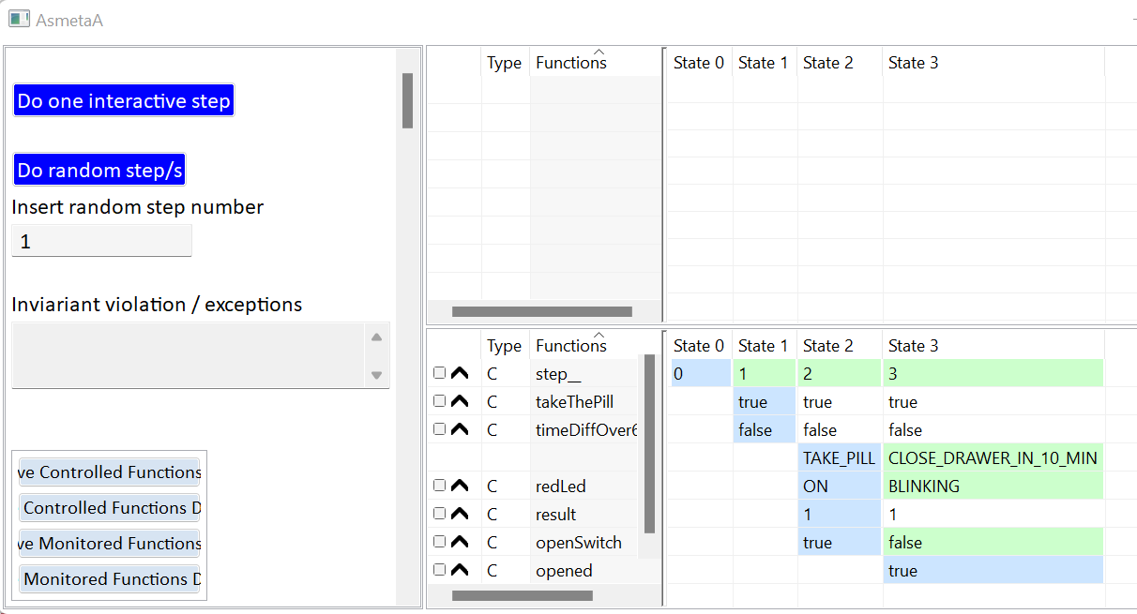
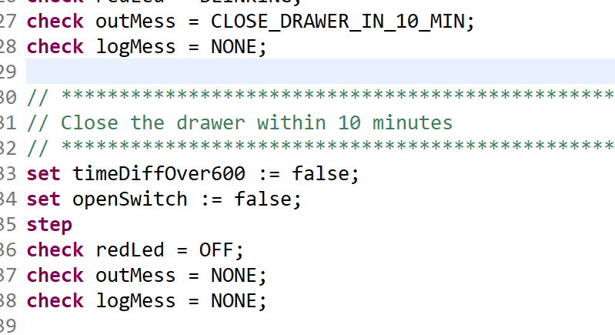
Simulation <-> scenarios
From the animator to avalla
Animate the avalla

Slide 18

Scenarios and refinement
Scenarios can be automatically refined when a specification is refined
ASM level i
scenario
Paolo Arcaini, Elvinia Riccobene,
Automatic Refinement of ASM Abstract Test Cases
A-MOST workshop 2019 IEEE International Conference on Software Testing, Verification and Validation
Model checker
ASM level i +1
A way to check if:
The refinement is correct
It captures the desired behaviors
    Manual checking of scenarios
refined scenario

Slide 19
Automatic generation of scenarios
ASM
Using the model checker and its capability to generate counter examples,
Several coverage criteria
The user cna inspect and validate the scenarios
scenarios

Slide 20
Scenarios and traceability (ABZ 2021)
requirements
scenario
RQ1: ….
Establish a link between requirements and rules
scenario
Covers r_rq1
Asmeta spec
//RQ1: ….
rule r_rq1
The validator links scenarios and rules

Slide 21
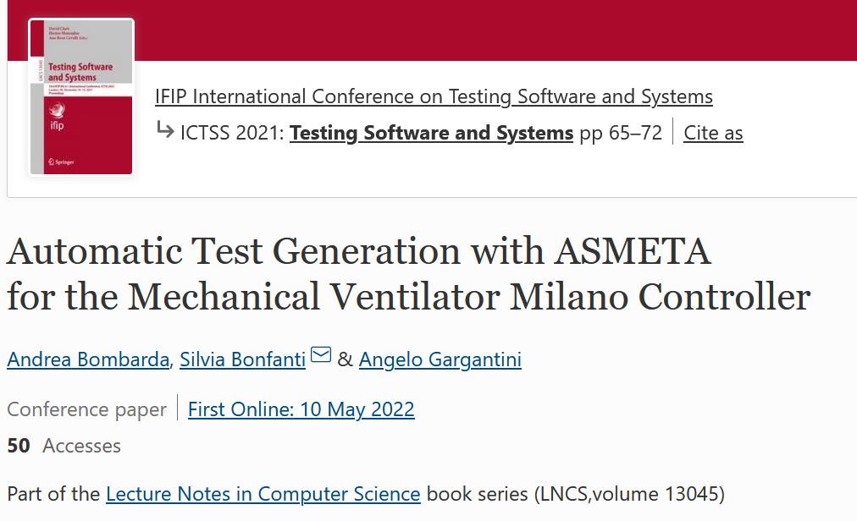
From scenarios to unit tests for code
Scenarios can be translated to executable Unit test code

Slide 22
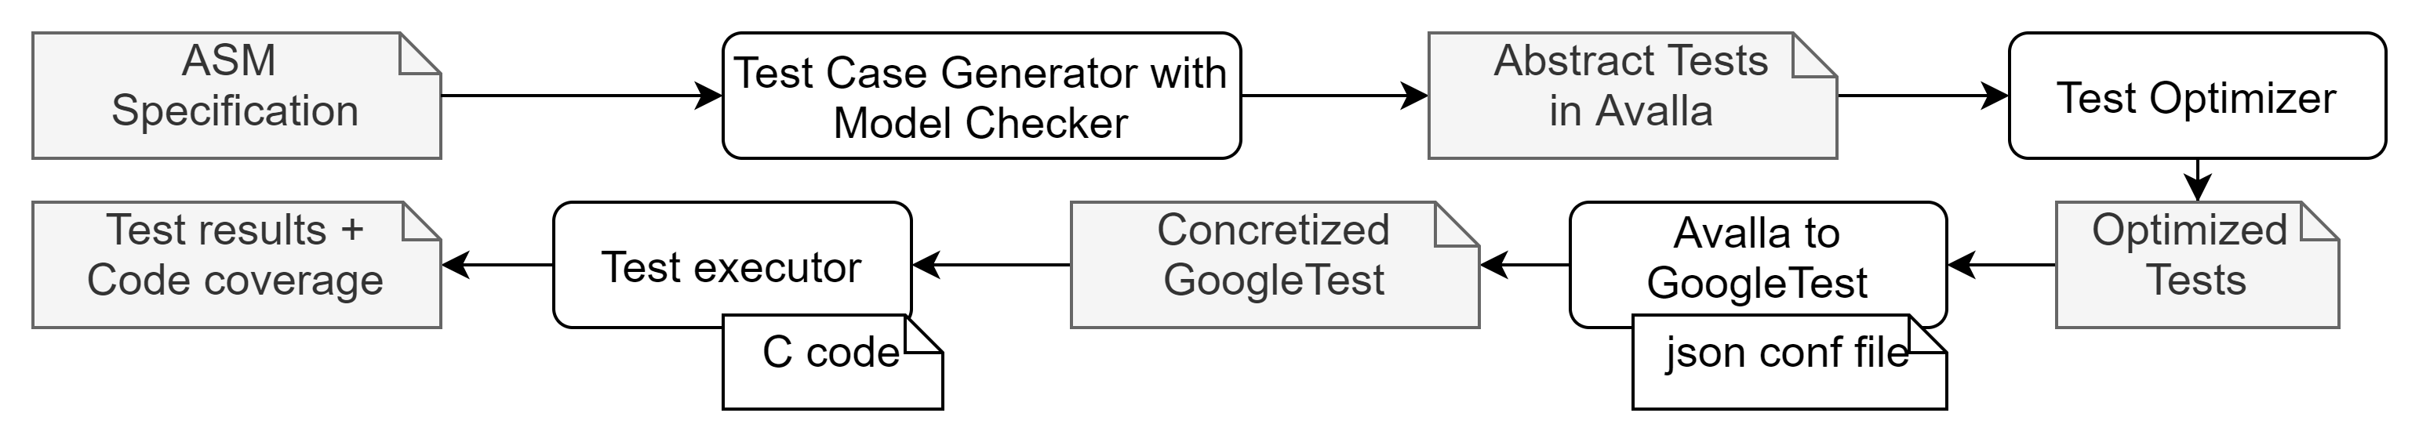
Test generation and execution process
ATGT

Slide 23
