Slide 2
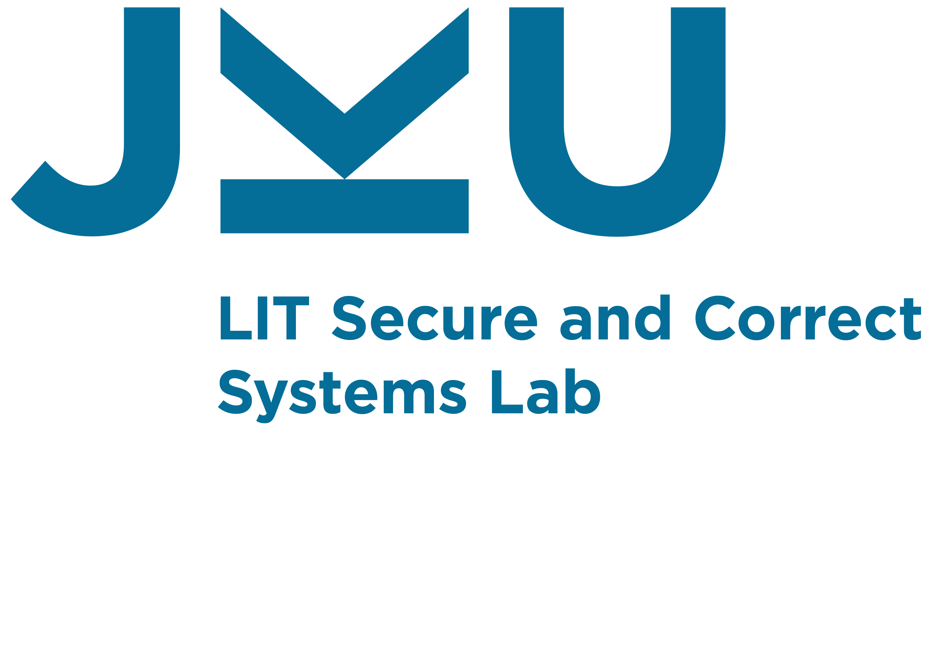
Validation Obligations:
A Novel Approach to Check Compliance between Requirements and their Formal Specification
IVOIRE Workshop
June 07, 2022
Lugano, Switzerland
Atif Mashkoor

Slide 3

Table of contents
Motivation
Methodology
IVOIRE project
Conclusion

Slide 4

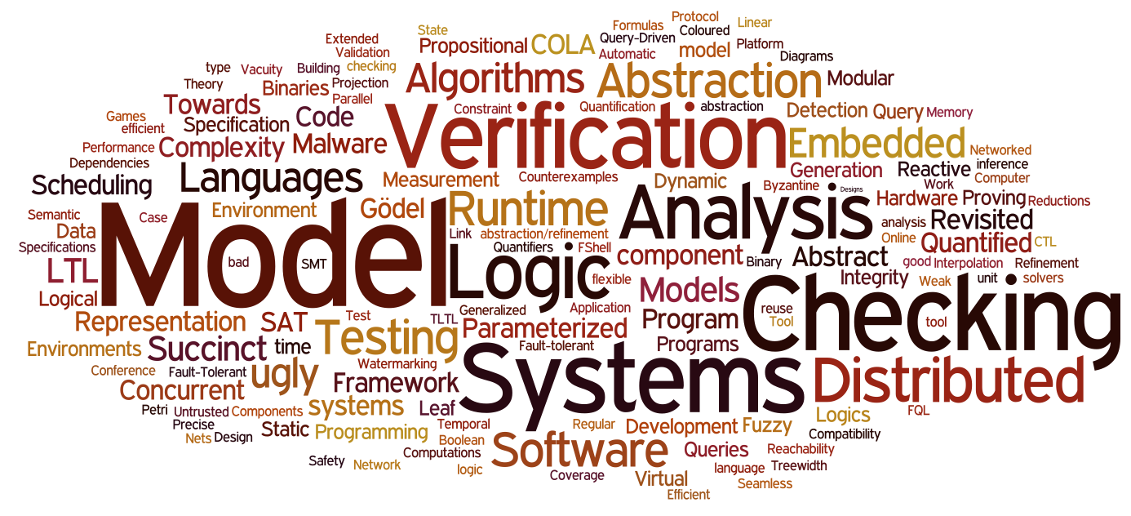
Motivation
The use of formal methods is highly recommended for quality assurance (QA) of safety-critical systems
Techniques for programs specification, development and reasoning about their correctness based on mathematics and logic
Verification often takes the center stage
Validation is somehow neglected, especially in the stepwise refinement process

Slide 5
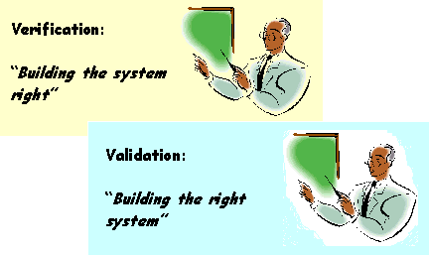
Stepwise model development
Verification, e.g., proofs
Abstract model
Validation, e.g., animation
Verification, e.g., proofs
Refinement
Validation, e.g., animation
Verification, e.g., proofs
Refinement
Validation, e.g., animation
Implementation

Slide 6

Proof obligations vs validation obligations
Proof obligation (PO) is a logical formula associated with the consistency claim of a given verification property
Verification(specification) = Σ POs(specification)
Analogous to the idea of PO, we propose to break the overall validation of a specification and associate it with each refinement step
A validation obligation (VO) is a logical formula associated with the correctness claim of a given validation property
Validation(specification) = Σ VOs(specification)

Slide 7
Validation obligation
A validation obligation (VO) is composed of (multiple) validation tasks (VT) associated with a model to check its compliance with the requirement

Slide 8
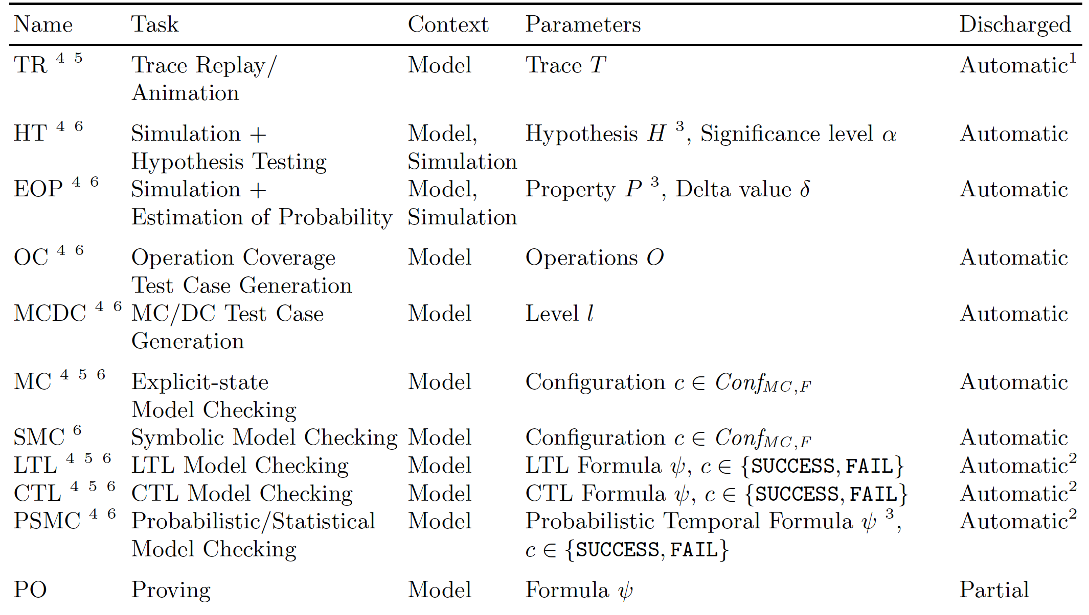
Validation tasks

Slide 9


Integration of Validation into a Refinement-based Rigorous Development Process (IVOIRE)
Time frame: Oct 2020 – Sep 2023
Source: DACH (FWF-DFG)
Principle investigators
  Atif Mashkoor
  Michael Leuschel
  Alexander Egyed
Project staff
  Sebastian Stock
  Fabian Vu
  David Geleßus

Slide 10
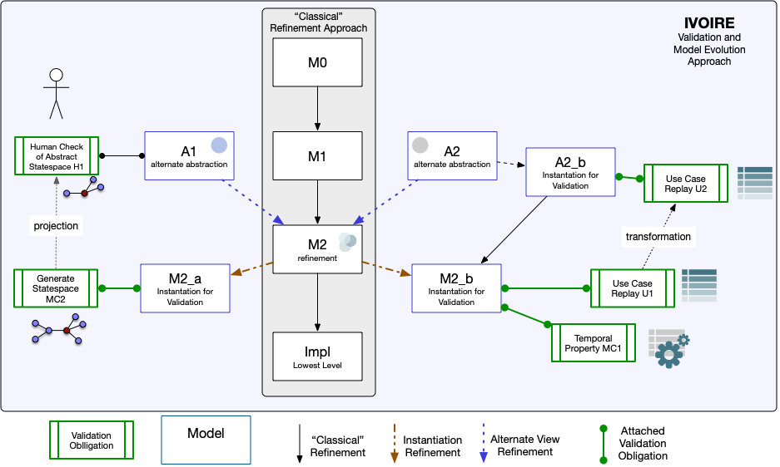

Slide 11
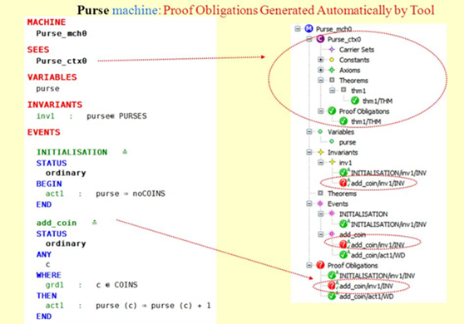
Rigorous method (Event-) B
Set theory and first-order logic
1-1 level of refinement, higher degree of automatic proofs
Correctness by design
Old and proven, much industrial experience
Good tool support, esp. for verification
ProB
Atif Mashkoor, Felix Kossak, Alexander Egyed: Evaluating the suitability of state-based formal methods for industrial deployment. Software: Practice & Experience 48(12): 2350-2379 (2018)

Slide 12

Conclusion
The cost of failures is high in safety-critical systems
Verification and validation are equally important activities, hence merit equal attention
The IVOIRE methodology puts validation in the center of refinement-based development
VOs can provide POs like semantics to the concept of formal validation

